Slide 1

Chapter 11
Data Link Control
11.<number>
Copyright © The McGraw-Hill Companies, Inc. Permission required for reproduction or display.

Slide 2
11-1 FRAMING
The data link layer needs to pack bits into frames, so that each frame is distinguishable from another. Our postal system practices a type of framing. The simple act of inserting a letter into an envelope separates one piece of information from another; the envelope serves as the delimiter.
Topics discussed in this section:
Fixed-Size Framing
Variable-Size Framing
11.<number>

Slide 3

Figure 11.1 A frame in a character-oriented protocol
11.<number>

Slide 4

Figure 11.2 Byte stuffing and unstuffing
11.<number>

Slide 5

Note
Byte stuffing is the process of adding 1 extra byte whenever there is a flag or escape character in the text.
11.<number>

Slide 6

Figure 11.3 A frame in a bit-oriented protocol
11.<number>

Slide 7
Note
Bit stuffing is the process of adding one extra 0 if 011111 is encountered in data, so that the receiver does not mistake
the pattern 0111110 for a flag.
11.<number>

Slide 8

Figure 11.4 Bit stuffing and unstuffing
11.<number>

Slide 9
11-2 FLOW AND ERROR CONTROL
The most important responsibilities of the data link layer are flow control and error control. Collectively, these functions are known as data link control.
Topics discussed in this section:
Flow Control
Error Control
11.<number>

Slide 10
Note
Flow control refers to a set of procedures used to restrict the amount of data
that the sender can send before
waiting for acknowledgment.
Aka: Don’t overwhelm the receiver!
11.<number>

Slide 11
Note
Error control in the data link layer is based on automatic repeat request, which is the retransmission of data.
11.<number>

Slide 12
11-3 PROTOCOLS
Now let us see how the data link layer can combine framing, flow control, and error control to achieve the delivery of data from one node to another.
11.<number>

Slide 13

Figure 11.5 Taxonomy of protocols discussed in this chapter
11.<number>

Slide 14
11-4 NOISELESS CHANNELS
Let us first assume we have an ideal channel in which no frames are lost, duplicated, or corrupted. We introduce two protocols for this type of channel.
Topics discussed in this section:
Simplest Protocol
Stop-and-Wait Protocol
11.<number>

Slide 15

Figure 11.6 The design of the simplest protocol with no flow or error control
11.<number>

Slide 16
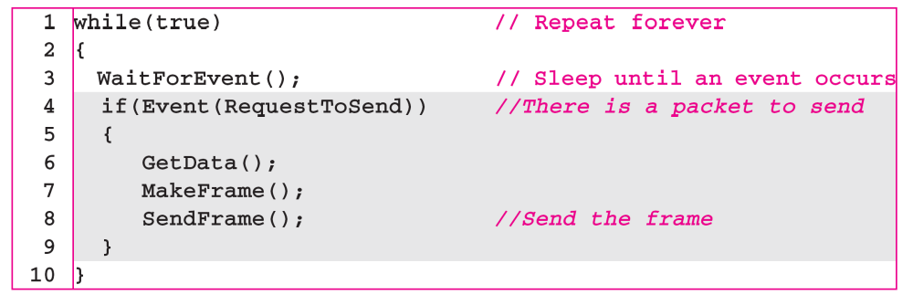
Algorithm 11.1 Sender-site algorithm for the simplest protocol
11.<number>

Slide 17
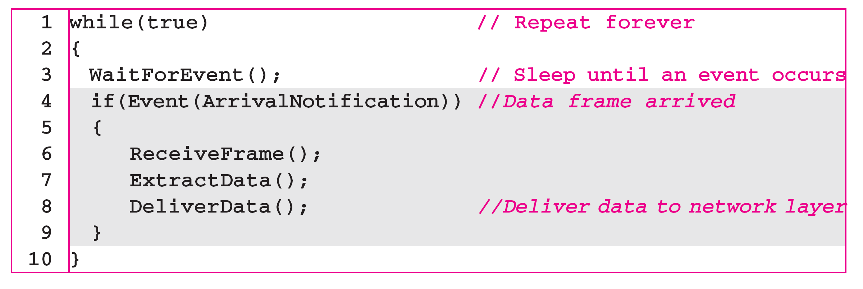
Algorithm 11.2 Receiver-site algorithm for the simplest protocol
11.<number>

Slide 18

Figure 11.7 Flow diagram for Example 11.1
11.<number>

Slide 19

Figure 11.8 Design of Stop-and-Wait Protocol
11.<number>

Slide 20
Algorithm 11.3 Sender-site algorithm for Stop-and-Wait Protocol
11.<number>

Slide 21
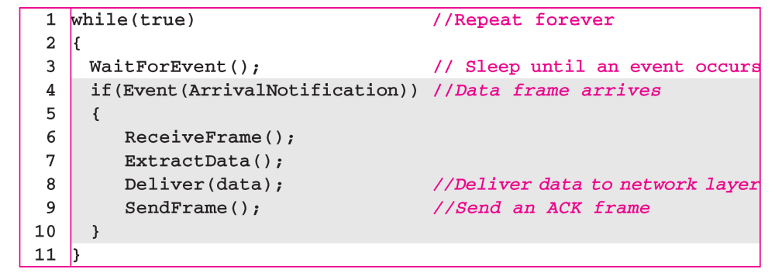
Algorithm 11.4 Receiver-site algorithm for Stop-and-Wait Protocol
11.<number>

Slide 22

Figure 11.9 Flow diagram for Example 11.2
11.<number>

Slide 23
11-5 NOISY CHANNELS
Although the Stop-and-Wait Protocol gives us an idea of how to add flow control to its predecessor, noiseless channels are nonexistent. We discuss three protocols in this section that use error control.
Topics discussed in this section:
Stop-and-Wait Automatic Repeat Request (ARQ)
Go-Back-N Automatic Repeat Request
Selective Repeat Automatic Repeat Request
11.<number>

Slide 24
Note
In Stop-and-Wait ARQ, the acknowledgment number always announces in modulo-2 arithmetic the sequence number of the next frame expected.
11.<number>

Slide 25

Figure 11.10 Design of the Stop-and-Wait ARQ Protocol
11.<number>

Slide 26
Stop-and-Wait ARQ Overview
Sender waits “reasonable” amount of time for ACK
  Thus Sender needs a countdown timer
  Start the timer when a packet is sent
  retransmits if no ACK received within the timeout period
if pkt (or ACK) just delayed (not lost):
  retransmission will create duplicate packet
  Thus it requires packet sequence number and ack number to be used
  Only two numbers are used: 0, 1
Receiver’s Ack number is what he is expected next
  After receiving Pkt 0, sends back ACK 1
  After receiving Pkt 1, sends back ACK 0
Transport Layer
3-<number>

Slide 27
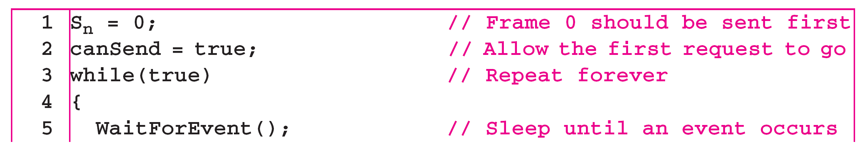
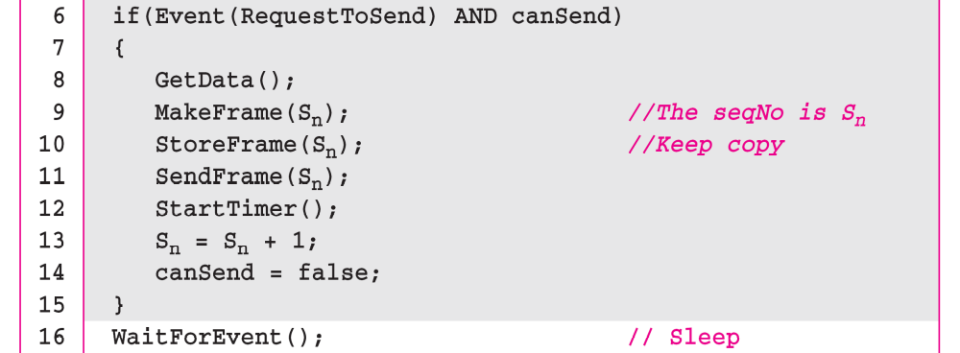
Algorithm 11.5 Sender-site algorithm for Stop-and-Wait ARQ
Modulo-2 addition
(continued)
11.<number>

Slide 28
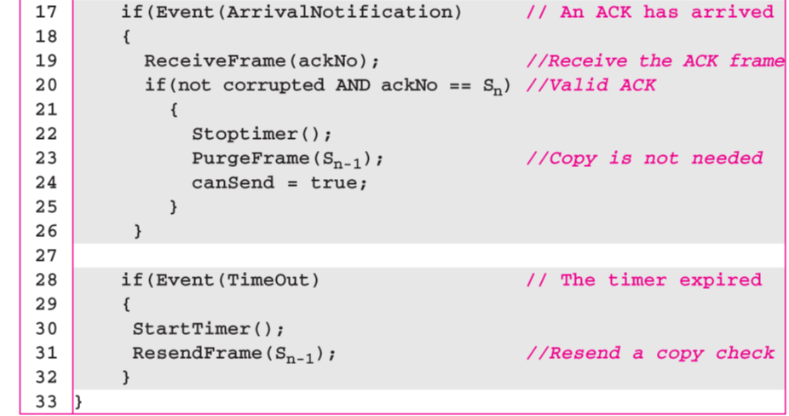
Algorithm 11.5 Sender-site algorithm for Stop-and-Wait ARQ
(continued)
11.<number>

Slide 29
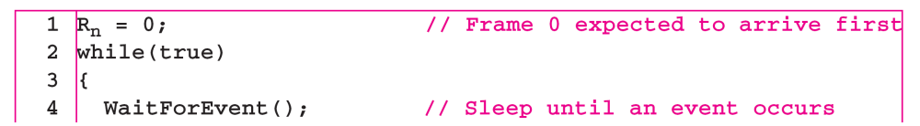
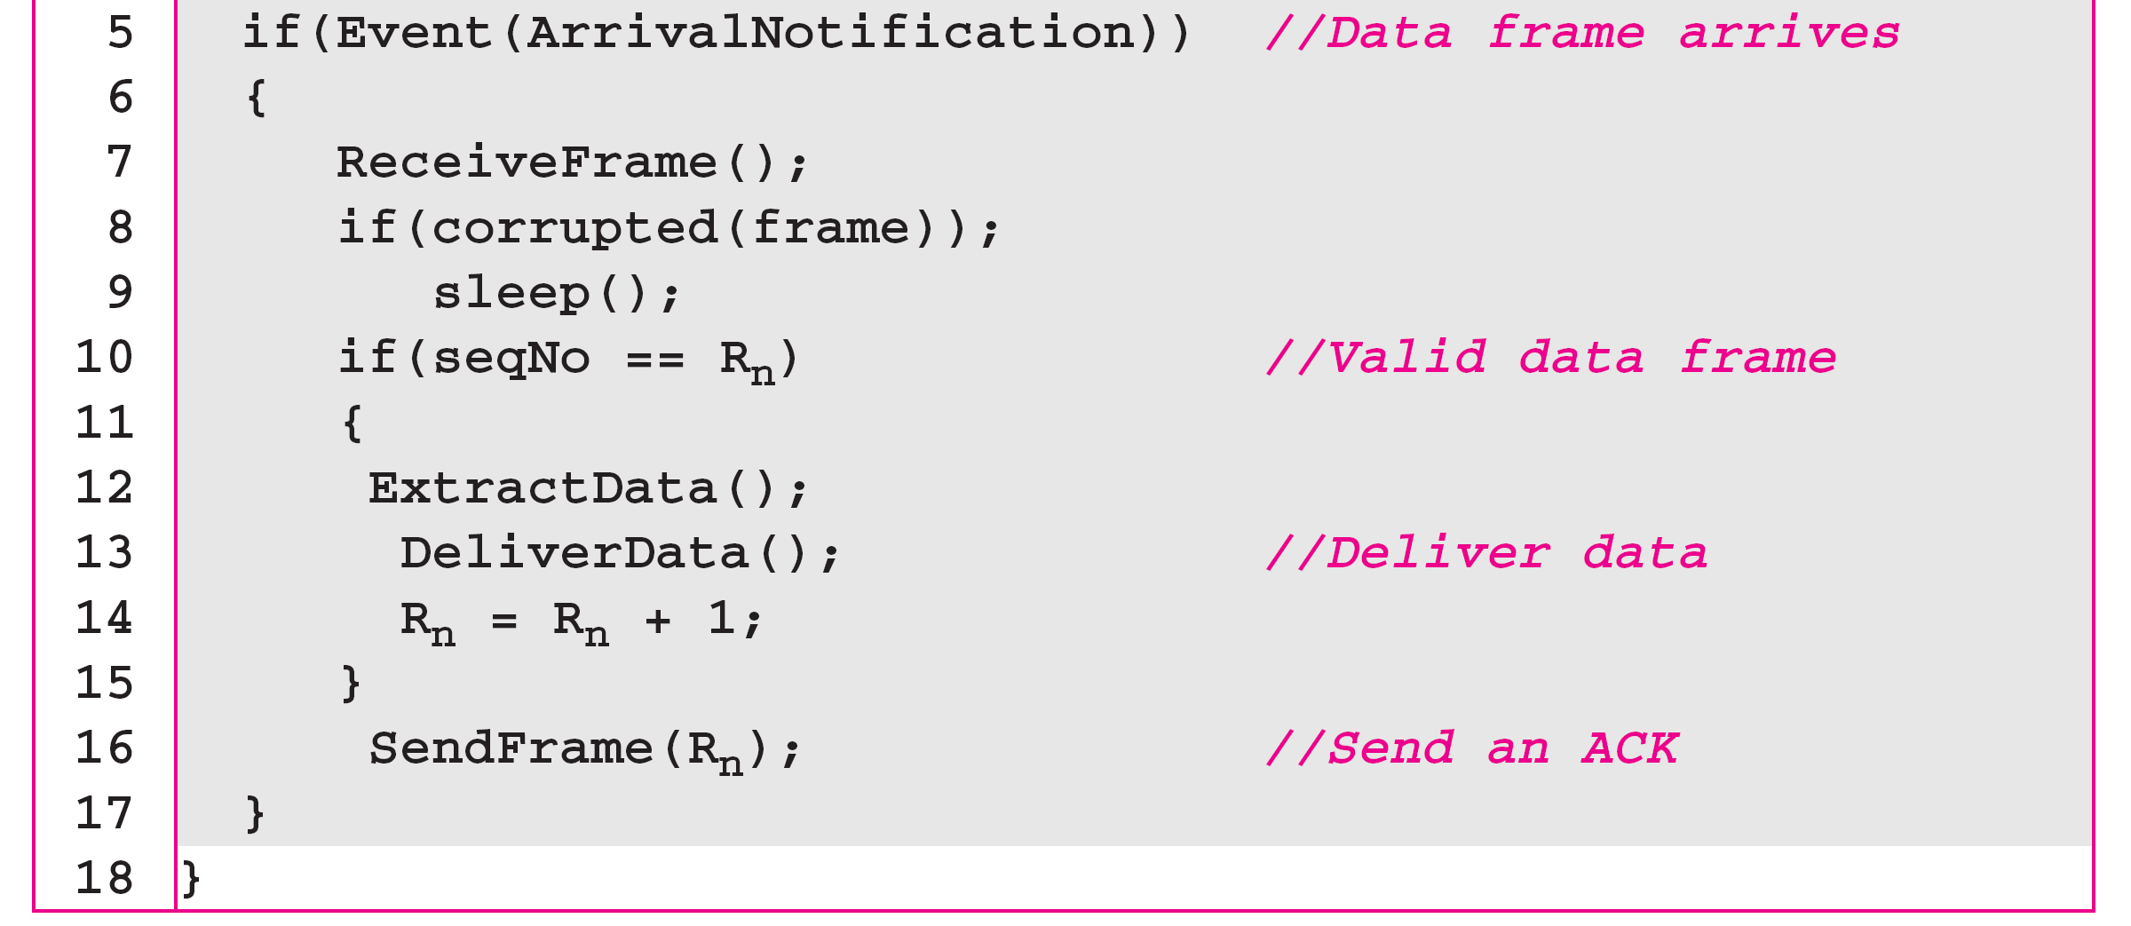
Algorithm 11.6 Receiver-site algorithm for Stop-and-Wait ARQ Protocol
Modulo-2 addition
R_{n} is the sequence number of
the next packet expected
11.<number>

Slide 30

Figure 11.11 Flow diagram for Example 11.3
11.<number>

Slide 31
Stop-and-wait operation
sender
receiver
first packet bit transmitted, t = 0
first packet bit arrives
RTT
last packet bit arrives, send ACK
ACK arrives, send next
packet, t = RTT + L / R
L: packet bit length
R: link bandwidth (bps)
Utilization = L/R / (RTT+L/R)

Slide 32
Example 11.4
Assume that, in a Stop-and-Wait ARQ system, the bandwidth of the line is 1 Mbps, and 1 bit takes 20 ms to make a round trip. If the system data frames are 1000 bits in length, what is the utilization percentage of the link?
Solution
L = 1000 bits, R = 1Mbps, RTT = 20ms
Utilization = 1/ 21 = 4.8%
For this reason, for a link with a high bandwidth or long delay, the use of Stop-and-Wait ARQ wastes the capacity of the link.
11.<number>

Slide 33
Pipelining: increased utilization
sender
receiver
first packet bit transmitted, t = 0
last bit transmitted, t = L / R
first packet bit arrives
RTT
last packet bit arrives, send ACK
last bit of 2nd packet arrives, send ACK
last bit of 3rd packet arrives, send ACK
ACK arrives, send next
packet, t = RTT + L / R
Increase utilization
by a factor of 3!
Utilization = 3*L/R / (RTT+L/R)
Transport Layer
3-<number>

Slide 34
Example 11.5
What is the utilization percentage of the link in Example 11.4 if we have a protocol that can send up to 15 frames before stopping and worrying about the acknowledgments?
Solution
11.<number>

Slide 35

Pipelined protocols
Pipelining: sender allows multiple, “in-flight”, yet-to-be-acknowledged pkts
  range of sequence numbers must be increased
  buffering at sender and/or receiver
Two generic forms of pipelined protocols:
  go-Back-N, selective repeat
Transport Layer
3-<number>

Slide 36

Figure 11.12 Send window for Go-Back-N ARQ
11.<number>

Slide 37
Note
The send window is an abstract concept defining an imaginary box of size 2^{m} − 1 with three variables: Sf, Sn, and S_{size}.
The send window can slide one
or more slots when a valid acknowledgment arrives.
Cumulative ACK
ACK(n): ACKs all pkts up to and include seq # n-1 have been received may receive duplicate ACKs (see receiver)
A single timer for the oldest transmitted but un-acked pkt
timeout: retransmit all pkts in window (up to N packets)
11.<number>

Slide 38

Figure 11.13 Receive window for Go-Back-N ARQ
11.<number>

Slide 39
Note
The receive window is an abstract concept defining an imaginary box of size 1 with one single variable R_{n}.
The window slides when a correct frame has arrived; sliding occurs one slot at a time.
out-of-order pkt:
  discard (don’t buffer) -> no receiver buffering!
  Re-ACK pkt with highest in-order seq #
11.<number>

Slide 40
Note
Stop-and-Wait ARQ is a special case of Go-Back-N ARQ in which the size of the send window is 1.
11.<number>

Slide 41
Algorithm 11.7 Go-Back-N sender algorithm
(continued)
11.<number>

Slide 42
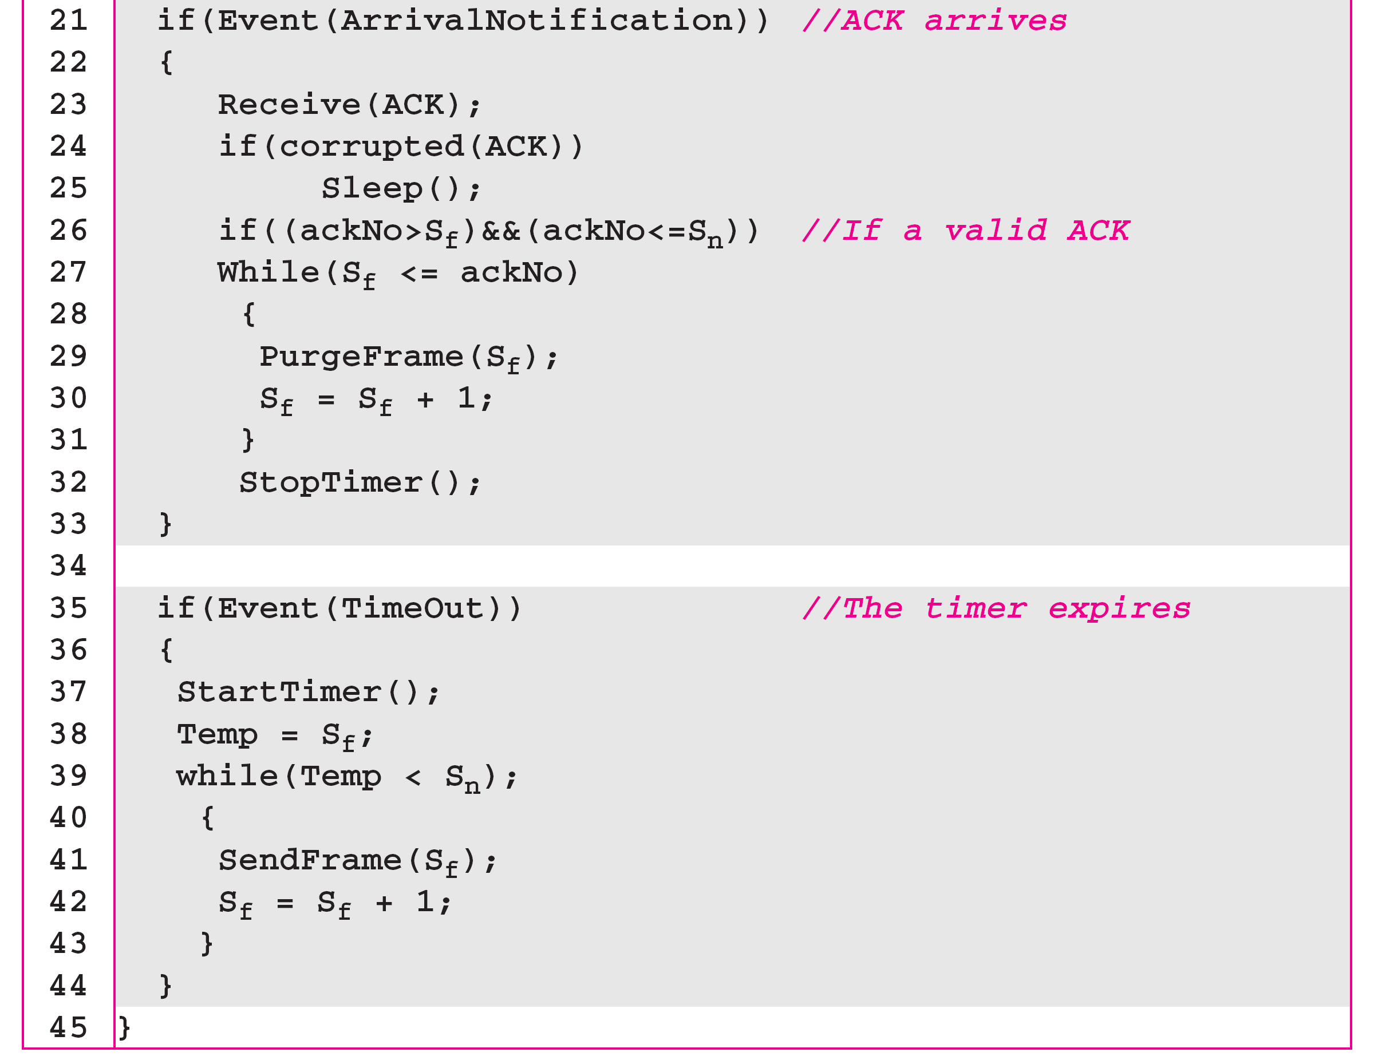
Algorithm 11.7 Go-Back-N sender algorithm
(continued)
{
If (S_{f} ==S_{n} ) // the window is empty
StopTimer();
Else
StartTimer();
{
Typo in Textbook!
11.<number>

Slide 43
Algorithm 11.8 Go-Back-N receiver algorithm
11.<number>

Slide 44
Sequence Numbers
Frames from a sender are numbered sequentially.
We need to set a limit since we need to include the sequence number of each frame in the header.
If the header of the frame allows m bits for sequence number, the sequence numbers range from 0 to 2 ^{m} – 1. for m = 3, sequence numbers are: 1, 2, 3, 4, 5, 6, 7.
We can repeat the sequence number.
Sequence numbers are:
0, 1, 2, 3, 4, 5, 6, 7, 0, 1, 2, 3, 4, 5, 6, 7, 0, 1, …

Slide 45
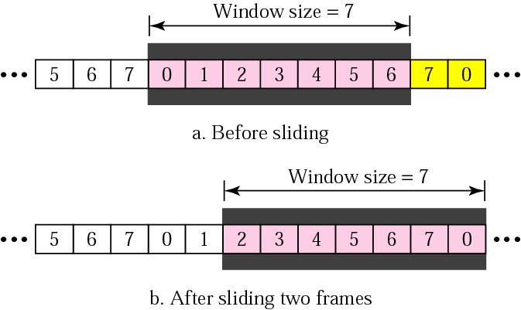
Sender Sliding Window
At the sending site, to hold the outstanding frames until they are acknowledged, we use the concept of a window.
The size of the window is at most 2^{m} -1 where m is the number of bits for the sequence number.
Size of the window can be variable, e.g. TCP.
The window slides to include new unsent frames when the correct ACKs are received

Slide 46
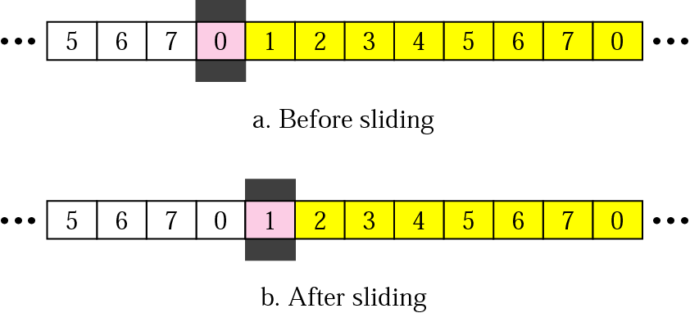
Receiver Sliding Window
Size of the window at the receiving site is always 1 in this protocol.
Receiver is always looking for a specific frame to arrive in a specific order.
Any frame arriving out of order is discarded and needs to be resent.
Receiver window slides as shown in fig. Receiver is waiting for frame 0 in part a.

Slide 47
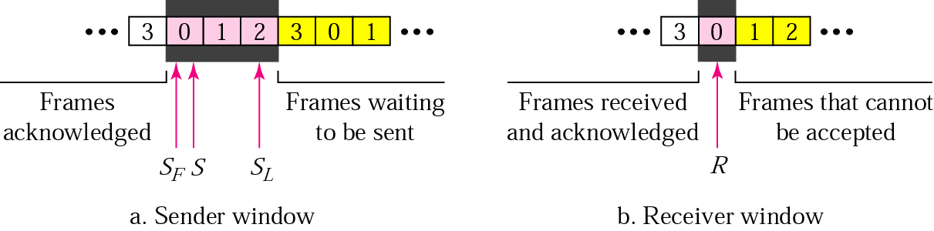
Control Variables
Sender has 3 variables: S, S_{F}, and S_{L}
S holds the sequence number of recently sent frame
S_{F} holds the sequence number of the first frame
S_{L} holds the sequence number of the last frame
Receiver only has the one variable, R, that holds the sequence number of the frame it expects to receive. If the seq. no. is the same as the value of R, the frame is accepted, otherwise rejected.

Slide 48
Acknowledgement
Receiver sends positive ACK if a frame arrived safe and in order.
If the frames are damaged/out of order, receiver is silent and discard all subsequent frames until it receives the one it is expecting.
The silence of the receiver causes the timer of the unacknowledged frame to expire.
Then the sender resends all frames, beginning with the one with the expired timer.
For example, suppose the sender has sent frame 6, but the timer for frame 3 expires (i.e. frame 3 has not been acknowledged), then the sender goes back and sends frames 3, 4, 5, 6 again. Thus it is called Go-Back-N-ARQ
The receiver does not have to acknowledge each frame received, it can send one cumulative ACK for several frames.

Slide 49
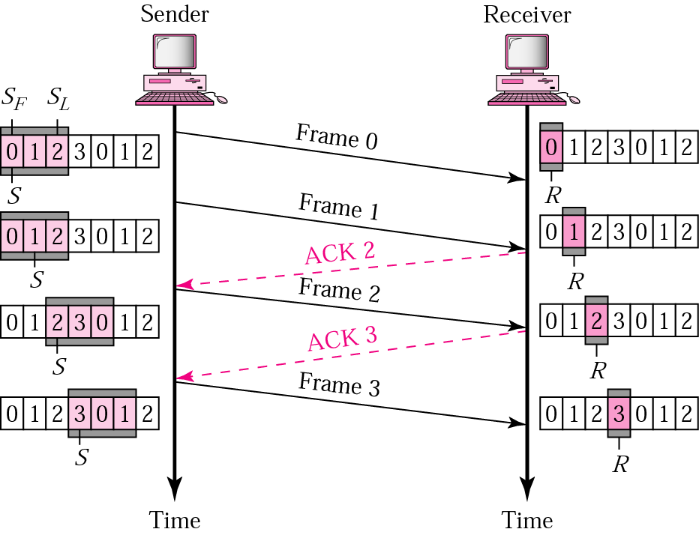
Go-Back-N ARQ, normal operation
The sender keeps track of the outstanding frames and updates the variables and windows as the ACKs arrive.

Slide 50
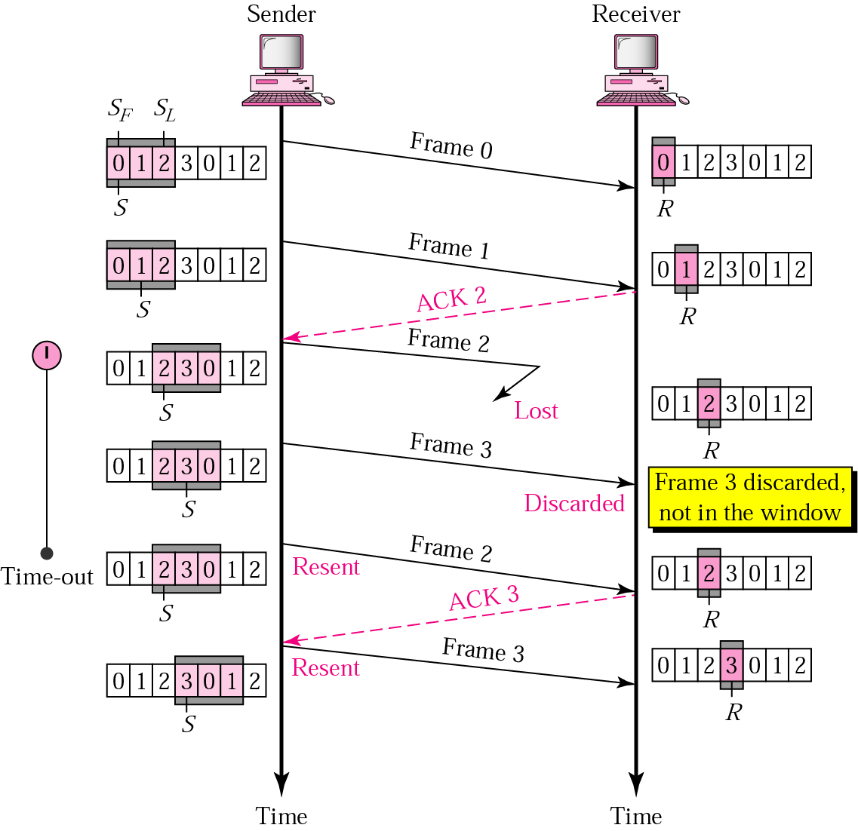
Go-Back-N ARQ, lost frame
Frame 2 is lost
When the receiver receives frame 3, it discards frame 3 as it is expecting frame 2 (according to window).
After the timer for frame 2 expires at the sender site, the sender sends frame 2 and 3. (go back to 2)

Slide 51
Go-Back-N ARQ, damaged/lost/delayed ACK
If an ACK is damaged/lost, we can have two situations:
If the next ACK arrives before the expiration of any timer, there is no need for retransmission of frames because ACKs are cumulative in this protocol.
If ACK1, ACK2, and ACk3 are lost, ACK4 covers them if it arrives before the timer expires.
If ACK4 arrives after time-out, the last frame and all the frames after that are resent.
Receiver never resends an ACK.
A delayed ACK also triggers the resending of frames

Slide 52
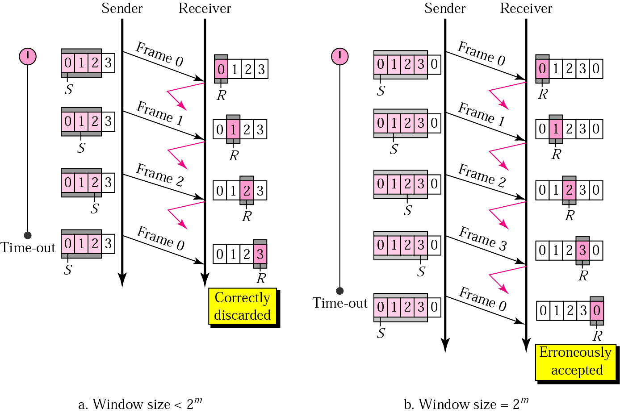
Go-Back-N ARQ, sender window size
Size of the sender window must be less than 2 ^{m}. Size of the receiver is always 1. If m = 2, window size = 2 ^{m} – 1 = 3.
Fig compares a window size of 3 and 4.
Accepts as the 1st frame in the next cycle-an error

Slide 53
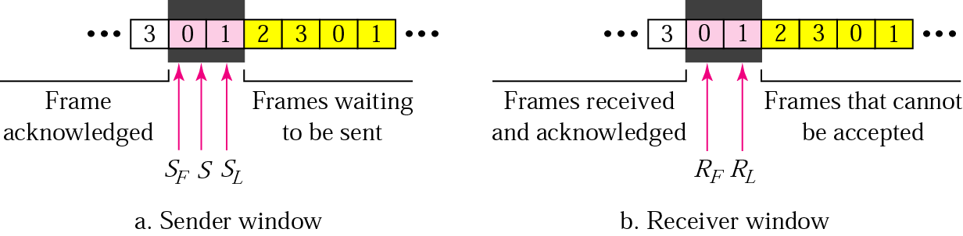
Selective Repeat ARQ, sender and receiver windows
Go-Back-N ARQ simplifies the process at the receiver site. Receiver only keeps track of only one variable, and there is no need to buffer out-of-order frames, they are simply discarded.
However, Go-Back-N ARQ protocol is inefficient for noisy link. It bandwidth inefficient and slows down the transmission.
In Selective Repeat ARQ, only the damaged frame is resent. More bandwidth efficient but more complex processing at receiver.
It defines a negative ACK (NAK) to report the sequence number of a damaged frame before the timer expires.

Slide 54
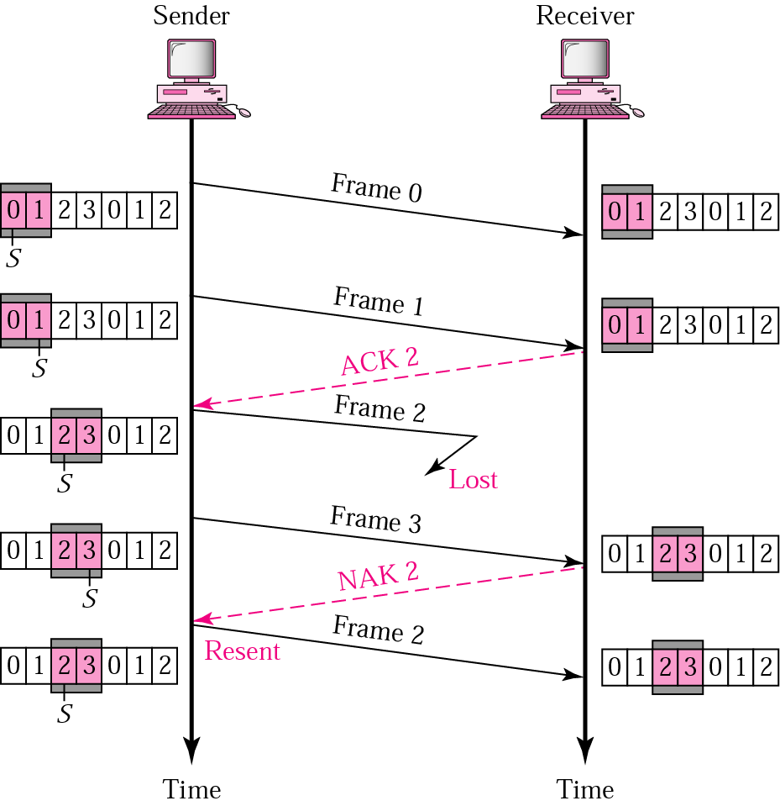
Selective Repeat ARQ, lost frame
Frames 0 and 1 are accepted when received because they are in the range specified by the receiver window. Same for frame 3.
Receiver sends a NAK2 to show that frame 2 has not been received and then sender resends only frame 2 and it is accepted as it is in the range of the window.

Slide 55
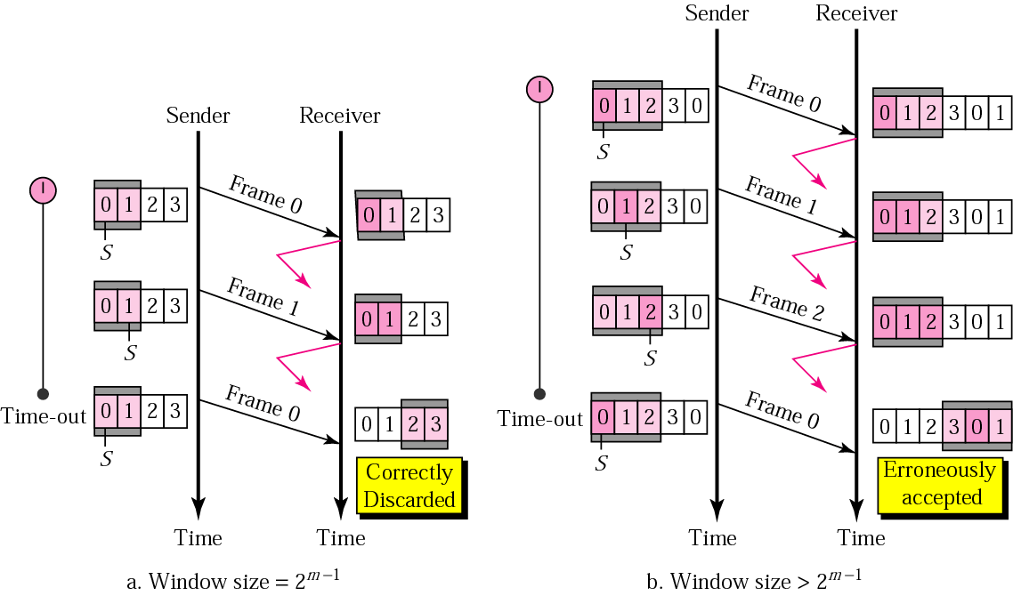
Selective Repeat ARQ, sender window size
Size of the sender and receiver windows must be at most one-half of 2 ^{m}. If m = 2, window size should be 2 ^{m} /2 = 2. Fig compares a window size of 2 with a window size of 3. Window size is 3 and all ACKs are lost, sender sends duplicate of frame 0, window of the receiver expect to receive frame 0 (part of the window), so accepts frame 0, as the 1st frame of the next cycle – an error.

Slide 56
Example 11.17 shows that because of one packet lost, all following
packets will need to be retransmitted, even if they have arrived at the destination → A great waste of bandwidth
Better protocol: selective repeat ARQ
11.<number>

Slide 57
Selective Repeat ARQ
Problem with Go-back-N:
  Sender: resend many packets with a single lose
  Receiver: discard many good received (out-of-order) packets
  Very inefficient when N becomes bigger (in high-speed network)
Solution: Receiver individually acknowledges all correctly received pkts
  buffers pkts, as needed, for eventual in-order delivery to upper layer
sender only resends pkts for which ACK not received
  sender keeps timer for each unACKed pkt
sender window
  N consecutive seq #’s
  again limits seq #s of sent, unACKed pkts

Slide 58


Figure 11.18 Send window for Selective Repeat ARQ
Figure 11.19 Receive window for Selective Repeat ARQ
11.<number>

Slide 59

Figure 11.23 Flow diagram for Example 11.8
11.<number>

